Slide 1
EMBT-ESE 4009
INTERFACING PUSH BUTTON WITH ESP32
Project topic: Health monitoring device using IOT -connected headphone
Group Number : 2
Group Members:
Christy Rachel Philip
Fahad Rahman
James M. Chacko
Premil Prasannan
Instructor : Mike Aleshams
Presented by,
Christy Rachel Philip

Slide 2
Contents
Introduction.
An Overview of the Project.
Engineering Drawing.
Block Diagram.
Hardware Overview of Push Button Switch.
Push button pinout diagram and explanation.
Interfacing Push button with ESP32.
Blynk Application.
Source Code.
Conclusion.
References.

Slide 3
Introduction
This presentation includes the details regarding one of the basic task of our project, which is the Interfacing of push button switch with ESP32 Microcontroller Board. As a part of that, we will explain major details of the NEO-6M GPS Module as well.

Slide 4
An Overview of the Project.
The topic of our project is “Health monitoring device using IOT-connected headphone.”
Our Project is an IoT-connected health care device, which is connected as a part of Bluetooth headphones. It consists of EKG sensor, pulse oximeter, temperature sensor, GPS and GSM to obtain various health-related data such as blood oxygen level, temperature, EKG and patients live location.
The device can be connected to a mobile phone through IoT. The user's information such as height, weight and previous history can add in the webserver earlier itself. Using this, the family doctor can access it directly and monitor the patient's condition every day and communicate with them. Along with this, it has two push-buttons as well, so in case of emergencies, patient’s can press it by themselves and send information to 911 and doctor. So one of it will send text messages and other one will give a call.

Slide 5
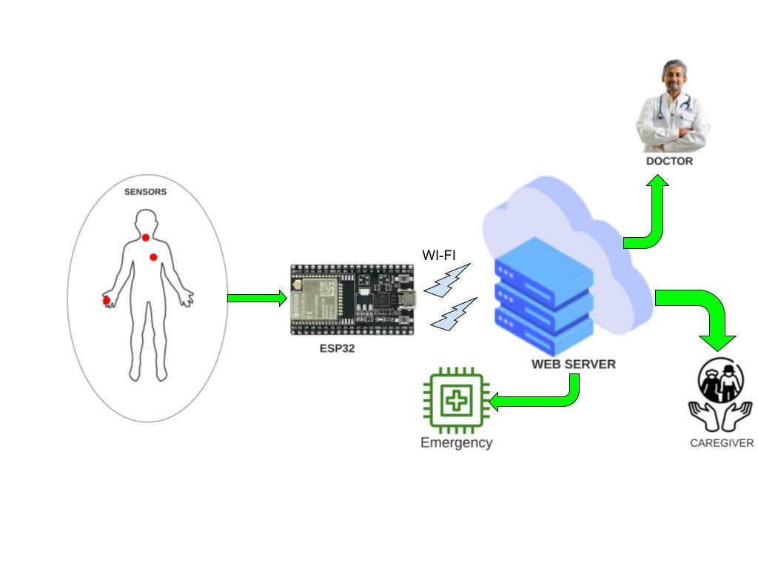
Engineering Drawing

Slide 6
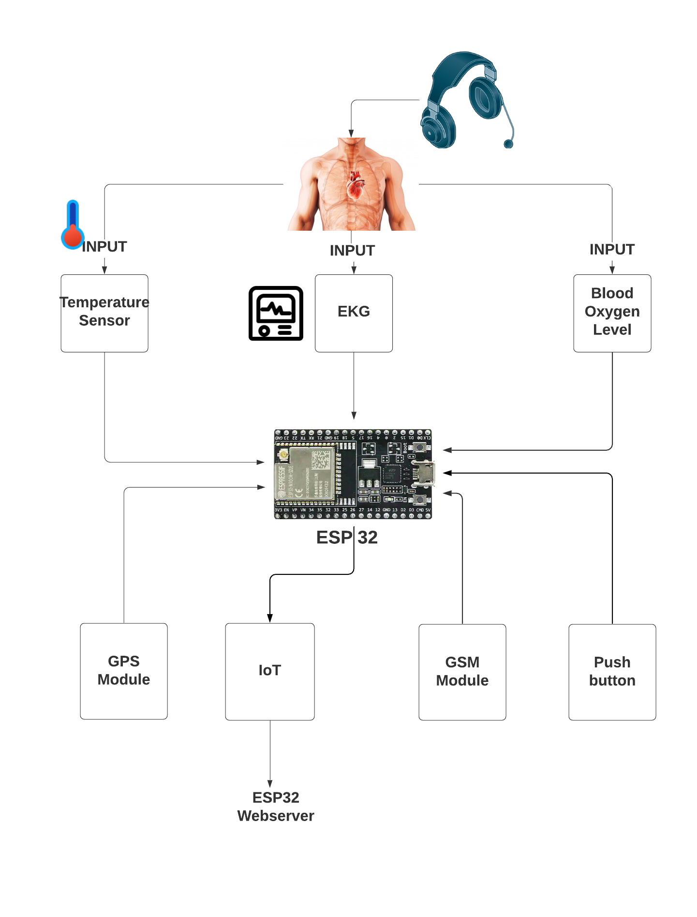
Block Diagram

Slide 7
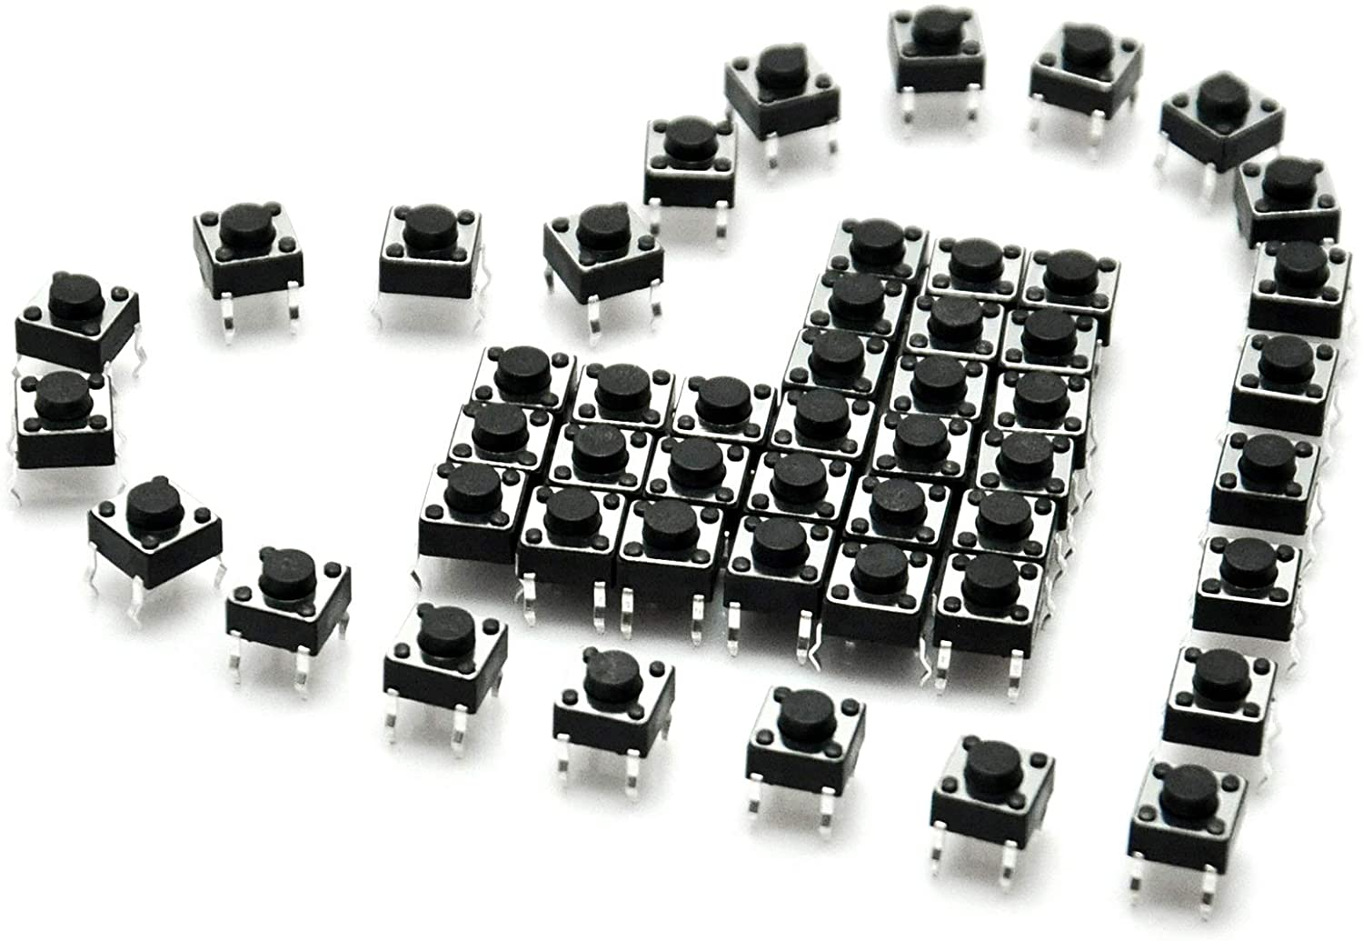
HARDWARE OVERVIEW OF PUSH BUTTON SWITCH

Slide 8
What is Tactile Switch or Push Button?
Tactile Switches, also known as push buttons, can be found everywhere: from phones to elevators to large industrial machines. They are the simplest type of input device.
A push button helps in closing an open electronic circuit or the reverse temporarily during the time it is pressed. It has a small spring which helps it to return to its original position when the user takes the pressure off the button.
There are mainly two types of push-buttons:
Normally open (NO)
Normally closed (NC).

Slide 9
What is Tactile Switch or Push Button?
Normally open (NO) Push Button
A circuit with a normally open push-button is open by default. When the user presses the button, the circuit becomes complete and the current starts flowing through it.
Normally closed (NC) Push Button
A circuit with a normally closed push-button is closed by default. The circuit breaks on pressing the button.

Slide 10
Features
Prevent flux rise by the insert-molded terminal
Snap-in mount terminal
Contact Bounce: MAX 5mS
Crisp clicking by tactile feedback
Dielectric Withstanding Voltage 250V AC for 1 minute
Ground terminal is attached

Slide 11
Technical Specifications
Mode of Operation: Tactile feedback
Power Rating: MAX 50mA 24V DC
Insulation Resistance: 100Mohm at 100v
Operating Force: 2.55±0.69 N
Contact Resistance: MAX 100mOhm
Operating Temperature Range: -20 to +70 ℃
Storage Temperature Range: -20 to +70 ℃

Slide 12
Where to use push button?
Push-Buttons are normally-open tactile switches. Push buttons allow us to power the circuit or make any particular connection only when we press the button. Simply, it makes the circuit connected when pressed and breaks when released. A push button is also used for triggering of the SCR by gate terminal. These are the most common buttons which we see in our daily life electronic equipment’s.

Slide 13
Applications
Calculators
Push-button telephones
Kitchen appliances
Magnetic locks
Various other mechanical and electronic devices, home and commercials.

Slide 14
PINOUT EXPLANATION

Slide 15
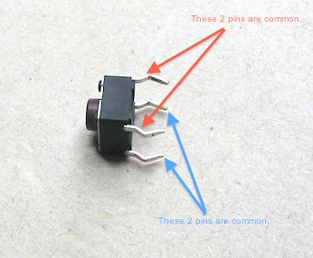
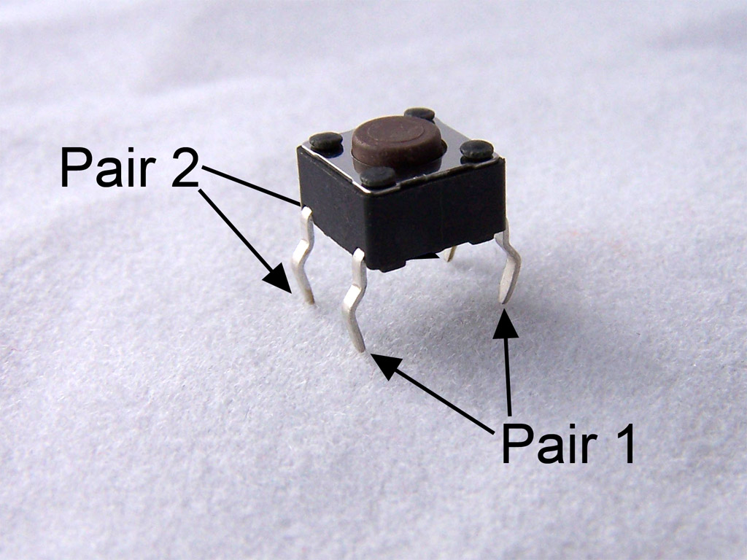
PINOUT EXPLANATION

Slide 16
PINOUT EXPLANATION
For push button switches, the pin 1 and 2 are internally connected and pin 3 and 4 are internally connected. From the above 3 images made it clear.
So if we give a connection to pin 1, it will get on pin 2 as well. Similarly for pin 3 and 4. When we establish a connection between pin 1 and 3 or 2 and 4, then the button would be pressed, else it would be in released state as shown in the first figure.

Slide 17
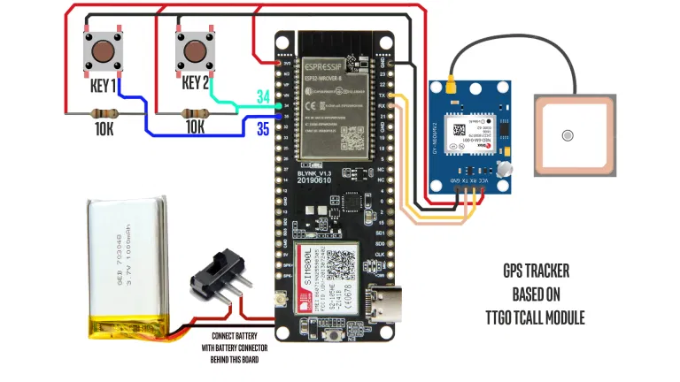
Interfacing of Push button with ESP32

Slide 18
Components Required
For Location Tracking
TTGO TCALL from ESP32
Neo6M GPS Module
3.7 V 600 mAh battery
For emergency features
Micro Switches x 2
Resistors x 2
Software part
Arduino IDE
Blynk Application

Slide 19
Working
The working of the project is quite simple. I have configured Blynk application to use GSM as the communication protocol. In the Blynk part I have provided a Map to show the location and and 5 value displays to display Latitude, Longitude, Speed, Direction and Number of satellites.
Now, as soon as the device is powered up it gets it location by using the GPS module and then pushes it the Blynk server through GSM which is then received and displayed on the Blynk application.
Talking about the emergency features. I do have added two microswitches in the PCB itself. Pressing one of which initiates a call to the mobile number mentioned in the code and the other sends an predefined emergency message to that number.

Slide 20
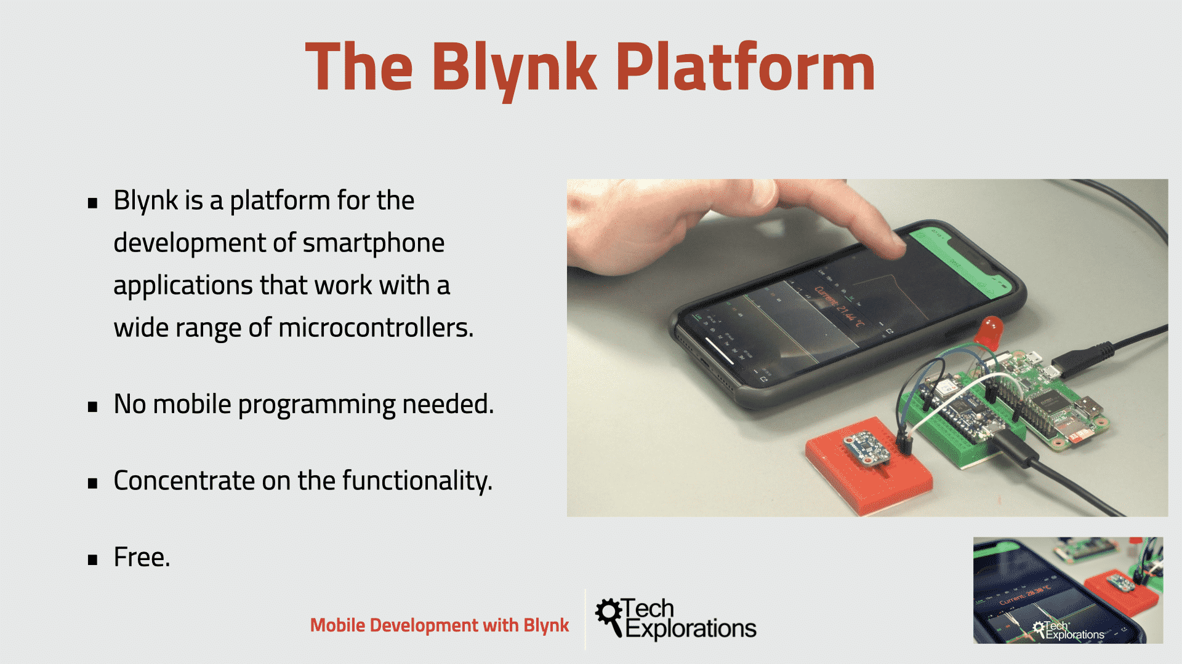
Blynk App
￼

Slide 21
Blynk App
With Blynk, you can create smartphone applications that allow you to easily interact with microcontrollers or even full computers such as the Raspberry Pi.
The main focus of the Blynk platform is to make it super-easy to develop the mobile phone application. As you will see in this course, developing a mobile app that can talk to your Arduino is as easy as dragging a widget and configuring a pin.
With Blynk, you can control an LED or a motor from your mobile phone with literally zero programming. But don’t let this simplicity make you think that Blynk is only useful for trivial applications. Blynk is a robust and scalable tool that is used by hobbyists and the industry alike.

Slide 22
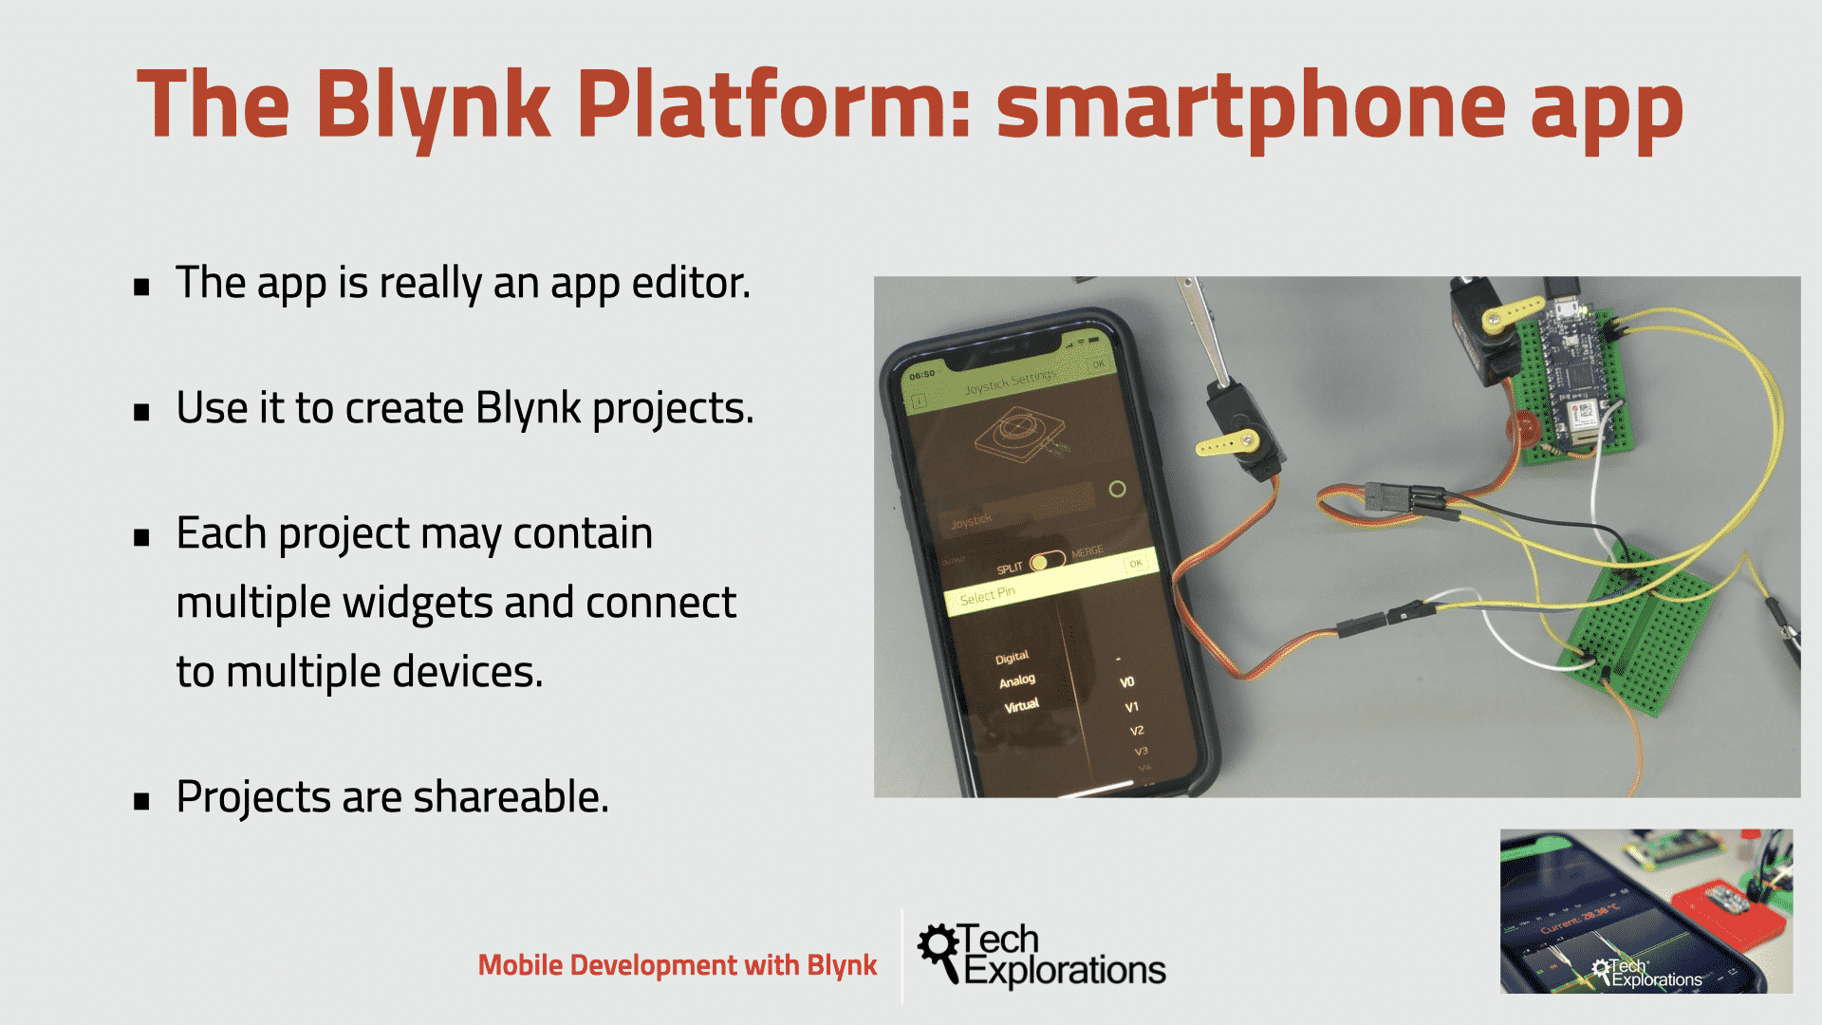
Blynk App

Slide 23
Blynk App
It allows to create one or more projects.
Each project can contain graphical widgets, like virtual LEDs, buttons, value displays and even a text terminal, and can interact with one or more devices. With the help of the Blynk library, it is possible to control Arduino or ESP32 pins directly from your phone, without having to write any code at all.
It is also possible to share a project with friends and even customers so that they can access the connected devices but not be able to modify the project. Imagine a scenario where you build a smartphone application where you can control lights, window blinds and room temperature from your phone. You can share the project with other family members so that they can also access the functionality.

Slide 24
Source Code
// TTGO T-Call pin definitions
#define MODEM_RST 5
#define MODEM_PWKEY 4
#define MODEM_POWER_ON 23
#define MODEM_TX 27
#define MODEM_RX 26
#define I2C_SDA 21
#define I2C_SCL 22
#include <TinyGPS++.h> //https://github.com/mikalhart/TinyGPSPlus
#include <AceButton.h> // https://github.com/bxparks/AceButton
#define BLYNK_PRINT Serial
#define BLYNK_HEARTBEAT 30
#define TINY_GSM_MODEM_SIM800
#include <TinyGsmClient.h> // https://github.com/vshymanskyy/TinyGSM
#include <BlynkSimpleSIM800.h> //https://github.com/blynkkk/blynk-library
#include <Wire.h>
// #include <TinyGsmClient.h>
#include "utilities.h"

Slide 25
Source Code
using namespace ace_button;
//Buttons
#define SMS_Button 34
#define Call_Button 35
// Emergency Number and Message
String message = "It's an Emergency. I'm at this location ";
String mobile_number = "Mobile Number with country code";
String message_with_data;
// Variables for storing GPS Data
float latitude;
float longitude;
float speed;
float satellites;
String direction;

Slide 26
Source Code
// Switch
ButtonConfig config1;
AceButton call_button(&config1);
ButtonConfig config2;
AceButton sms_button(&config2);
void handleEvent_call(AceButton*, uint8_t, uint8_t);
void handleEvent_sms(AceButton*, uint8_t, uint8_t);
// Set serial for GPS Module
#define SerialMon Serial
// Hardware Serial for builtin GSM Module
#define SerialAT Serial1
const char apn[] = "www";
const char user[] = "";
const char pass[] = "";

Slide 27
Source Code
// You should get Auth Token in the Blynk App.
// Go to the Project Settings (nut icon).
const char auth[] = "YOUR_AUTH_TOKEN";
//static const int RXPin = 4, TXPin = 5;
static const uint32_t GPSBaud = 9600;
TinyGPSPlus gps;
WidgetMap myMap(V0);
//SoftwareSerial ss(RXPin, TXPin);
BlynkTimer timer;
TinyGsm modem(SerialAT);
unsigned int move_index = 1;

Slide 28
Source Code
void setup()
{
// Set console baud rate
Serial.begin(9600);
delay(10);
// Keep power when running from battery
Wire.begin(I2C_SDA, I2C_SCL);
bool isOk = setPowerBoostKeepOn(1);
SerialMon.println(String("IP5306 KeepOn ") + (isOk ? "OK" : "FAIL"));
// Set-up modem reset, enable, power pins
pinMode(MODEM_PWKEY, OUTPUT);
pinMode(MODEM_RST, OUTPUT);
pinMode(MODEM_POWER_ON, OUTPUT);
pinMode(SMS_Button, INPUT);
pinMode(Call_Button, INPUT);

Slide 29
Source Code
pinMode(SMS_Button, INPUT);
pinMode(Call_Button, INPUT);
digitalWrite(MODEM_PWKEY, LOW);
digitalWrite(MODEM_RST, HIGH);
digitalWrite(MODEM_POWER_ON, HIGH);
// Set GSM module baud rate and UART pins
SerialAT.begin(115200, SERIAL_8N1, MODEM_RX, MODEM_TX);
delay(3000);
// Restart takes quite some time
// To skip it, call init() instead of restart()
SerialMon.println("Initializing modem...");
modem.restart();

Slide 30
Source Code
String modemInfo = modem.getModemInfo();
SerialMon.print("Modem: ");
SerialMon.println(modemInfo);
// Unlock your SIM card with a PIN
//modem.simUnlock("1234");
SerialMon.print("Waiting for network...");
if (!modem.waitForNetwork(240000L)) {
SerialMon.println(" fail");
delay(10000);
return;
}
SerialMon.println(" OK");

Slide 31
Source Code
if (modem.isNetworkConnected()) {
SerialMon.println("Network connected");
}
SerialMon.print(F("Connecting to APN: "));
SerialMon.print(apn);
if (!modem.gprsConnect(apn, user, pass)) {
SerialMon.println(" fail");
delay(10000);
return;
}
SerialMon.println(" OK");
// ss.begin(GPSBaud);
Blynk.begin(auth, modem, apn, user, pass);
timer.setInterval(5000L, checkGPS);
config1.setEventHandler(handleEvent_call);
config2.setEventHandler(handleEvent_sms);

Slide 32
Source Code
call_button.init(Call_Button);
sms_button.init(SMS_Button);
}
void checkGPS()
{
if (gps.charsProcessed() < 10)
{
//Serial.println(F("No GPS detected: check wiring."));
Blynk.virtualWrite(V4, "GPS ERROR");
}
}
void loop()
{
while (Serial.available() > 0)
{
if (gps.encode(Serial.read()))
displayInfo();
}

Slide 33
Source Code
Blynk.run();
timer.run();
sms_button.check();
call_button.check();
}
void displayInfo()
{
if (gps.location.isValid() )
{
latitude = (gps.location.lat()); //Storing the Lat. and Lon.
longitude = (gps.location.lng());

Slide 34
Source Code
//Serial.print("LAT: ");
//Serial.println(latitude, 6); // float to x decimal places
//Serial.print("LONG: ");
//Serial.println(longitude, 6);
Blynk.virtualWrite(V1, String(latitude, 6));
Blynk.virtualWrite(V2, String(longitude, 6));
myMap.location(move_index, latitude, longitude, "GPS_Location");
speed = gps.speed.kmph(); //get speed
Blynk.virtualWrite(V3, speed);
direction = TinyGPSPlus::cardinal(gps.course.value()); // get the direction
Blynk.virtualWrite(V4, direction);
satellites = gps.satellites.value(); //get number of satellites
Blynk.virtualWrite(V5, satellites);
}

Slide 35
Source Code
digitalWrite(MODEM_PWKEY, LOW);
digitalWrite(MODEM_RST, HIGH);
digitalWrite(MODEM_POWER_ON, HIGH);
// Set GSM module baud rate and UART pins
SerialAT.begin(115200, SERIAL_8N1, MODEM_RX, MODEM_TX);
delay(3000);
// Restart takes quite some time
// To skip it, call init() instead of restart()
SerialMon.println("Initializing modem...");
modem.restart();
String modemInfo = modem.getModemInfo();
SerialMon.print("Modem: ");
SerialMon.println(modemInfo);
// Unlock your SIM card with a PIN
//modem.simUnlock("1234");
SerialMon.print("Waiting for network...");
if (!modem.waitForNetwork(240000L)) {
SerialMon.println(" fail");
delay(10000);
return;
}
SerialMon.println(" OK");
if (modem.isNetworkConnected()) {
SerialMon.println("Network connected");
}
SerialMon.print(F("Connecting to APN: "));
SerialMon.print(apn);
if (!modem.gprsConnect(apn, user, pass)) {
SerialMon.println(" fail");
delay(10000);
return;
}
SerialMon.println(" OK");
// ss.begin(GPSBaud);
Blynk.begin(auth, modem, apn, user, pass);
timer.setInterval(5000L, checkGPS);
config1.setEventHandler(handleEvent_call);
config2.setEventHandler(handleEvent_sms);
call_button.init(Call_Button);
sms_button.init(SMS_Button);
}
void checkGPS()
{
if (gps.charsProcessed() < 10)
{
//Serial.println(F("No GPS detected: check wiring."));
Blynk.virtualWrite(V4, "GPS ERROR");
}
}
void loop()
{
while (Serial.available() > 0)
{
if (gps.encode(Serial.read()))
displayInfo();
}
Blynk.run();
timer.run();
sms_button.check();
call_button.check();
}
void displayInfo()
{
if (gps.location.isValid() )
{
latitude = (gps.location.lat()); //Storing the Lat. and Lon.
longitude = (gps.location.lng());
//Serial.print("LAT: ");
//Serial.println(latitude, 6); // float to x decimal places
//Serial.print("LONG: ");
//Serial.println(longitude, 6);
Blynk.virtualWrite(V1, String(latitude, 6));
Blynk.virtualWrite(V2, String(longitude, 6));
myMap.location(move_index, latitude, longitude, "GPS_Location");
speed = gps.speed.kmph(); //get speed
Blynk.virtualWrite(V3, speed);
direction = TinyGPSPlus::cardinal(gps.course.value()); // get the direction
Blynk.virtualWrite(V4, direction);
satellites = gps.satellites.value(); //get number of satellites
Blynk.virtualWrite(V5, satellites);
}
//Serial.println();

Slide 36
Source Code
// function to send sms
void handleEvent_sms(AceButton* /* button */, uint8_t eventType,
uint8_t /* buttonState */) {
switch (eventType) {
case AceButton::kEventPressed:
// Serial.println("kEventPressed");
message_with_data = message + "Latitude = " + (String)latitude + "Longitude = " + (String)longitude;
modem.sendSMS(mobile_number, message_with_data);
message_with_data = "";
break;
case AceButton::kEventReleased:
//Serial.println("kEventReleased");
break;
}
}

Slide 37
Source Code
// function to do call
void handleEvent_call(AceButton* /* button */, uint8_t eventType,
uint8_t /* buttonState */) {
switch (eventType) {
case AceButton::kEventPressed:
// Serial.println("kEventPressed");
modem.callNumber(mobile_number);
break;
case AceButton::kEventReleased:
//Serial.println("kEventReleased");
break;
}
}

Slide 38
Conclusion
In this presentation we discussed the details regarding one of the basic task of our project, which is the Interfacing of Push button switch with ESP32 Microcontroller Board. As a part of that, we explained major details of the Push button switch as well.

Slide 39
References
Components 101. (2018, March 6). Push button Switch. https://components101.com/switches/push-button
Stempedia. (n.d.). What is Tactile Switch or Push Button? https://thestempedia.com/tutorials/what-is-tactile-switch-or-push-buttons/
HDK. (2007. May 29). Tactile switches, Data Sheet. https://components101.com/asset/sites/default/files/component_datasheet/Push-Button.pdf
Microcontrollers Lab (n.d.). Push button with ESP32 – GPIO pins as digital input https://microcontrollerslab.com/push-button-esp32-gpio-digital-input/
Techiesms. (2020, June 26). Github. https://github.com/techiesms/GPS-Tracker-via-GSM-using-TTGO-TCALL-Module-/tree/master/GPS Tracker with Call SMS
Priyanshu. (2020, June 26). Techiesms. https://techiesms.com/iot-projects/gsm-gprs-based-gps-tracker-with-calling-sms-features/
Tech Explorations. (n.d.). What is Blynk? A quick review. https://techexplorations.com/guides/blynk/1-what-is-blynk/

Slide 40
Thank you

